Slide 1


CS1010: Programming Methodology
UNIT 8
Conditional Statements
Live Q&A
https://pollev.com/jin

Slide 2
Unit 8: Conditional Statements
Sequential / Non-sequential Control Flow
if-else Statements
Skipping else
Conditional Operators
Nested if-else Statements
if-(else-if-)else… Statements

Slide 3
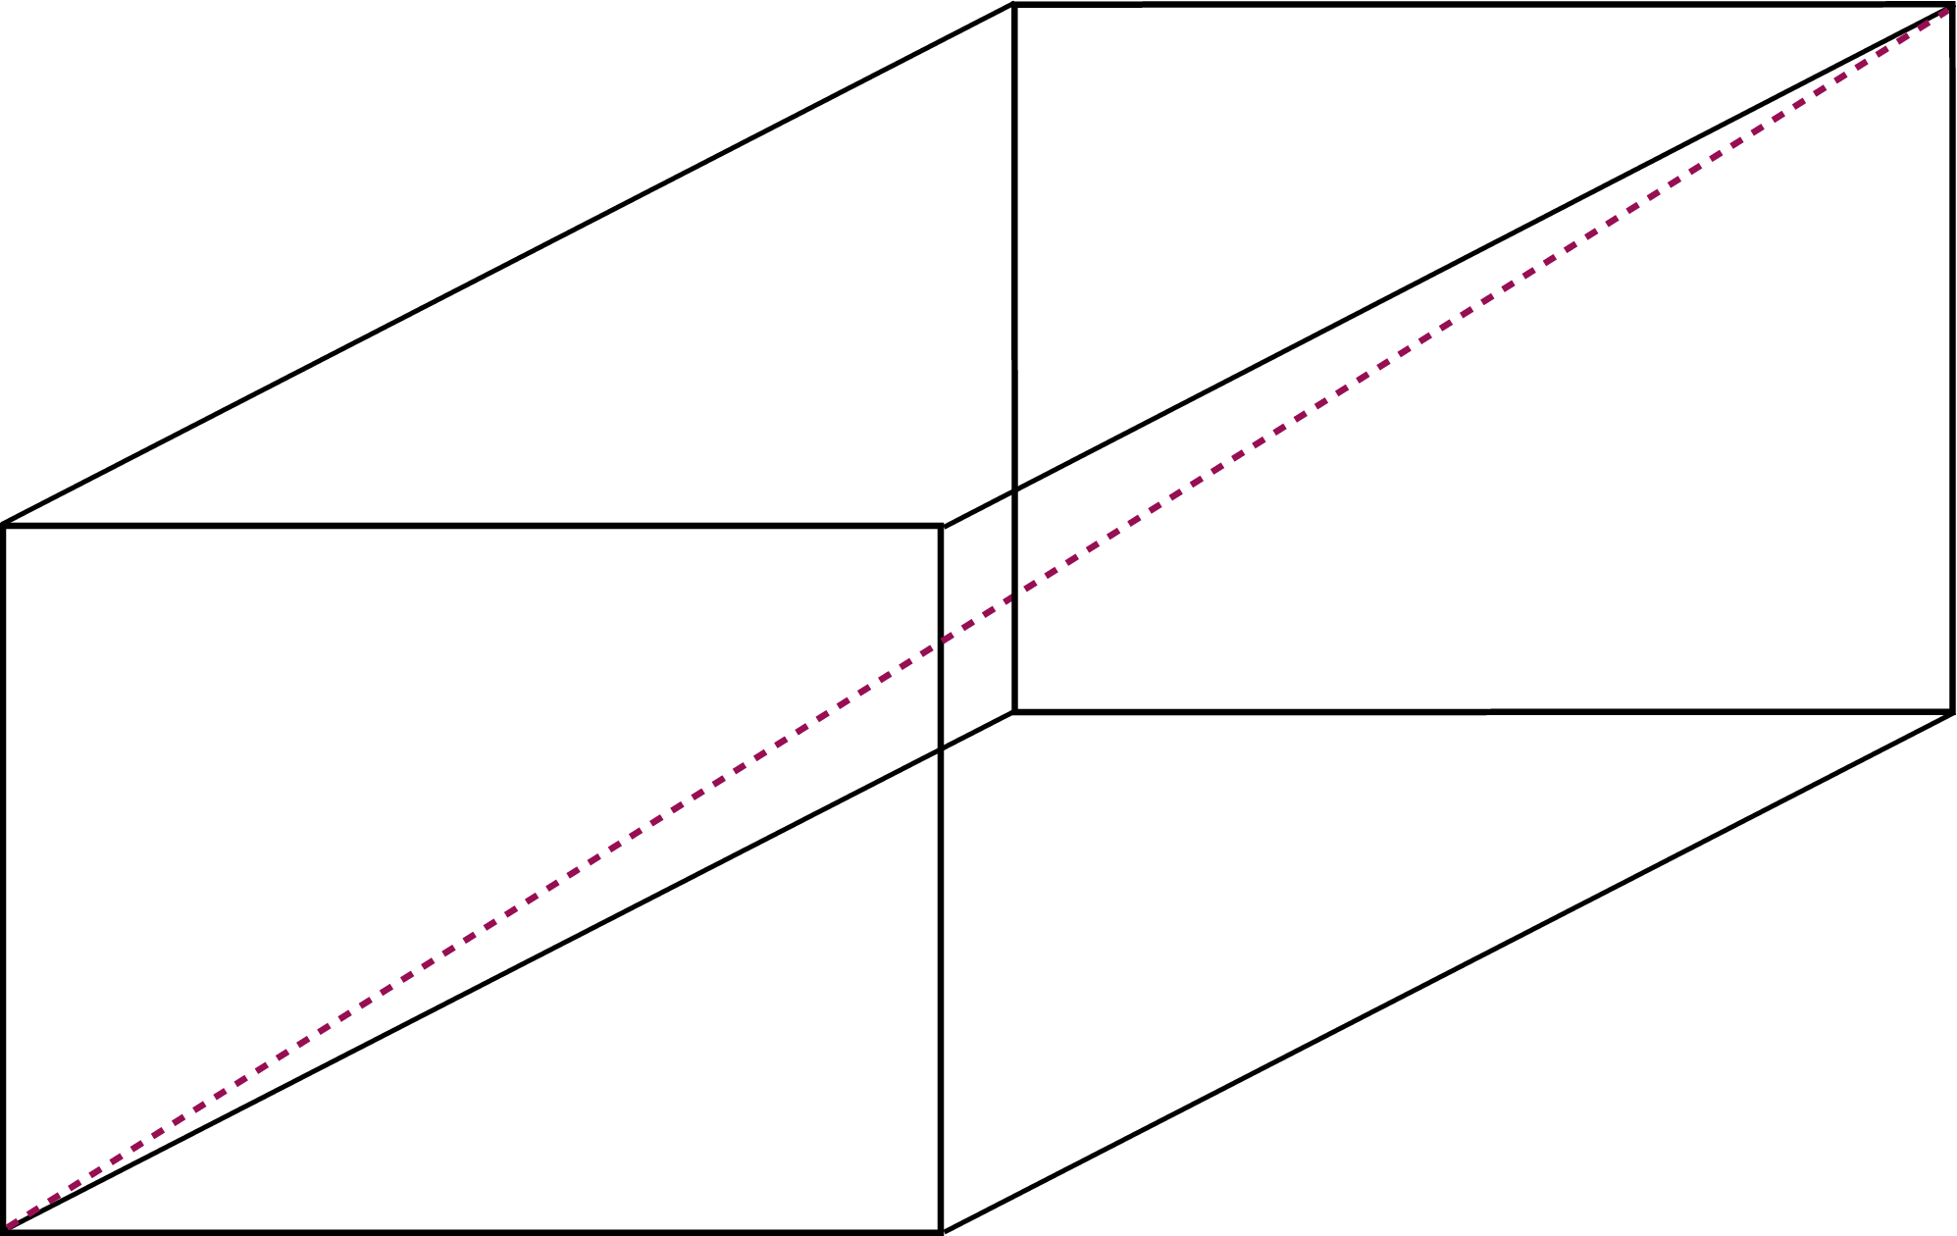
Sequential Control Flow
Ex00-Q6: Find the surface area and the diagonal of a cuboid
Algorithm Design
Input:
Read in the dimensions of the cuboid
Compute:
Compute the surface area and the diagonal
Output:
Print the surface area and the diagonal

Slide 4
Non-Sequential Control Flow
Ex00-Q6: Find the surface area and / or the diagonal of a cuboid depending on user input.
1 for surface area, 2 for diagonal, 3 for both
Algorithm Design
Input:
Read in the dimensions of the cuboid and the selected option

Slide 5
Non-Sequential Control Flow
Ex00-Q6: Find the surface area and / or the diagonal of a cuboid depending on user input.
1 for surface area, 2 for diagonal, 3 for both
Algorithm Design
Compute:
If option selected is 1 or 3, compute the surface area
If option selected is 2 or 3, compute the diagonal

Slide 6
Non-Sequential Control Flow
Ex00-Q6: Find the surface area and / or the diagonal of a cuboid depending on user input.
1 for surface area, 2 for diagonal, 3 for both
Algorithm Design
Output:
If option selected is 1 or 3, print the surface area
If option selected is 2 or 3, print the diagonal

Slide 7
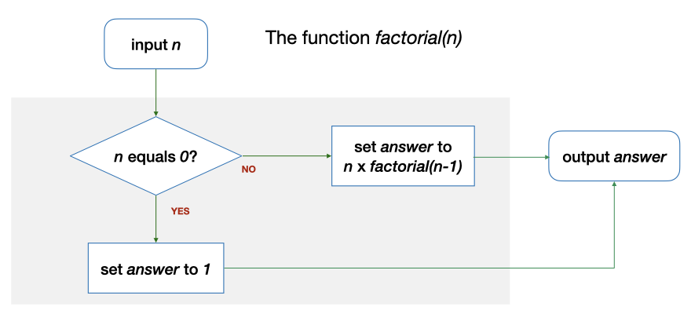
Non-Sequential Control Flow
Another example: Base case or Recursive case?

Slide 8
Non-Sequential Control Flow
Another example: Base case or Recursive case?
1
2
3
4
5
6
7
8
9
10
long factorial(long n)
{
long answer;
if (n == 0) {
answer = 1;
} else {
answer = n * factorial(n - 1);
}
return answer;
}

Slide 9
if-else Statements
if (n == 0) {
answer = 1;
} else {
answer = n * factorial(n - 1);
}
true
exp?
false
Syntax
if ( <logical expression> ) {
“true block”: statements to be executed if the expression is true
} else {
“false block”: statements to be executed if the expression is false
}

Slide 10

if-else Statements
if (n == 0) …
Comparison operators
==, !=, >, >=, <, <=
E.g., 2 < 3, n > 5, n % 2 != 0…
Common Mistakes
if (n = 0) …
This assigns 0 to n instead.
double expected_value = 0.3;
double sum = 0.1 + 0.2;
if (sum == expected_value) …
The expression could be false since not all real numbers can be represented accurately.

Slide 11
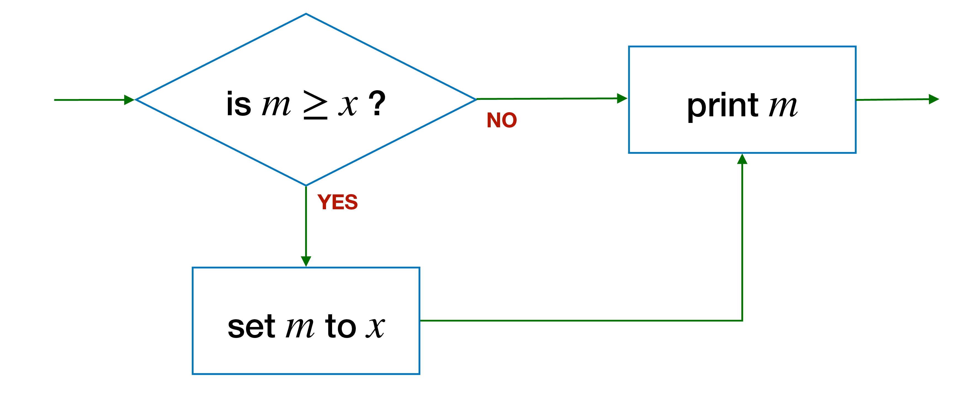
Skipping else
if (m >= x) {
m = x; // update m
} else {
??? // nothing to do
}
cs1010_println_long(m);
true
exp?
if (m >= x) {
m = x; // update max
}
cs1010_println_long(m);
false

Slide 12
Pop Quiz
Problem: Find the maximum value between 2 variables.
long getMax(long num1, long num2) { long max;
if (num1 > num2){ max = num1;
} if (num2 > num1)){ max = num2;
}
return max;
}
… long max;
if (num1 > num2){ max = num1;
} else {
max = num2;
}
return max;
…
What is wrong with this function?
What is the correct logic?

Slide 13
Conditional Operators
Problem: Find the maximum value between 2 variables.
… long max;
if (num1 > num2){ max = num1;
} else {
max = num2;
}
return max;
…
…
long max;
max = (num1 > num2) ? num1 : num2;
return max;
…
Syntax
condition ? true expression : false expression;

Slide 14
More than 2 possibilities?
Problem: Print a letter grade based on a score
A possible solution:
if score is 8 or higher → print A
if score is less than 8 but 5 or higher → print B
if score is less than 5 but 3 or higher → print C
if score is less than 3 → print D
Score | Letter Grade
8 or higher | A
Less than 8 but 5 or higher | B
Less than 5 but 3 or higher | C
Less than 3 | D
Completely separate steps!

Slide 15
More than 2 possibilities?
Problem: Print a letter grade based on a score
Score | Letter Grade
8 or higher | A
Else 5 or higher | B
Else 3 or higher | C
Else | D
Dependent on previous checks.
No nesting.
Score | Letter Grade
8 or higher | A
Else | 5 or higher | B
 | Else | 3 or higher | C
 | Less than 3 | Else | D
Dependent on previous checks.
With nesting.

Slide 16
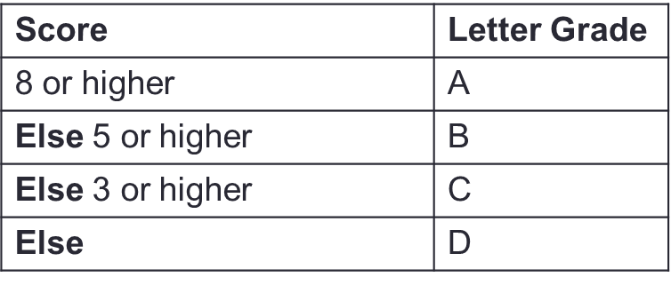
Nested if-else Statements
Problem: Print a letter grade based on a score
…
if (score >= 8) {
// print "A"
} else if (score >= 5) {
// print "B"
} else if (score >= 3) {
// print "C"
} else {
// print "D"
}
…

Slide 17
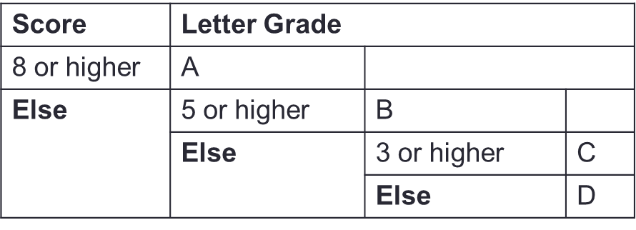
Nested if-else Statements
Problem: Print a letter grade based on a score
…
if (score >= 8) {
// print "A"
} else {
if (score >= 5) {
// print "B"
} else {
if (score >= 3) {
// print "C"
} else {
// print "D"
}
}
}
…

Slide 18
Nested if-else Statements
Problem: Print a letter grade based on a score
void print_score(double score)
{
if (score >= 8) {
cs1010_println_string("A");
} else {
if (score >= 5) {
cs1010_println_string("B");
} else {
if (score >= 3) {
cs1010_println_string("C");
} else {
cs1010_println_string("D");
}
}
}
}
Return type is void since the grade is printed but NOT returned.
cs1010_println_string(…) prints a string with a newline character.

Slide 19
Ex#1: CS1010 Schedule
Problem: Print the CS1010 schedule based on day (1/2/3/4/5) and time (1000/1100/…)
E.g., 1 and 1000 → output "Tutorial" 5 and 1200 → output "No activity"
Work out two sets of logic
Logic 1: Based on day and time together
Logic 2: Based on day first and then time.
 | 1000 | 1100 | 1200 | 1300 | 1400 | 1500 | 1600 | 1700
1 (Mon) | Tutorial | Tutorial | Tutorial | Tutorial | - | - | - | -
2 (Tue) | Lecture | Lecture | - | - | - | - | - | -
3 (Wed) | - | - | - | - | - | - | - | -
4 (Thu) | - | - | - | - | - | - | - | -
5 (Fri) | - | - | - | - | - | - | - | -

Slide 20
Ex#1: CS1010 Schedule
Logic 1:
if day equals 1 AND time is between 1000-1400 → output …
Otherwise, if day equals 2 AND time is between 1000-1200 → output …
Otherwise, if …
 | 1000 | 1100 | 1200 | 1300 | 1400 | 1500 | 1600 | 1700
1 (Mon) | Tutorial | Tutorial | Tutorial | Tutorial | - | - | - | -
2 (Tue) | Lecture | Lecture | - | - | - | - | - | -
3 (Wed) | - | - | - | - | - | - | - | -
4 (Thu) | - | - | - | - | - | - | - | -
5 (Fri) | - | - | - | - | - | - | - | -

Slide 21
Ex#1: CS1010 Schedule
Logic 2:
day equals 3/4/5 → output "No activity".
Otherwise
if day equals 1
if time is between 1000-1400 → …
Otherwise →
Otherwise …
 | 1000 | 1100 | 1200 | 1300 | 1400 | 1500 | 1600 | 1700
1 (Mon) | Tutorial | Tutorial | Tutorial | Tutorial | - | - | - | -
2 (Tue) | Lecture | Lecture | - | - | - | - | - | -
3 (Wed) | - | - | - | - | - | - | - | -
4 (Thu) | - | - | - | - | - | - | - | -
5 (Fri) | - | - | - | - | - | - | - | -

Slide 22
Ex#1: CS1010 Schedule
Logic 3?:
time is between …
…
 | 1000 | 1100 | 1200 | 1300 | 1400 | 1500 | 1600 | 1700
1 (Mon) | Tutorial | Tutorial | Tutorial | Tutorial | - | - | - | -
2 (Tue) | Lecture | Lecture | - | - | - | - | - | -
3 (Wed) | - | - | - | - | - | - | - | -
4 (Thu) | - | - | - | - | - | - | - | -
5 (Fri) | - | - | - | - | - | - | - | -

